Slide 1
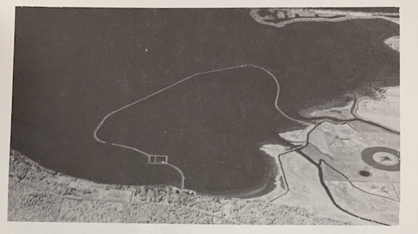
Lummi Nation Aquaculture:
A Community Based History
Created by a research group comprised of Anna Booker (Whatcom Community College), Daniel S. Chard (Western Washington University) and members of the Lummi Cultural Commission: Becky Jefferson , Juanita Jefferson, Natalia Hight, and Sheri Williams

Slide 2
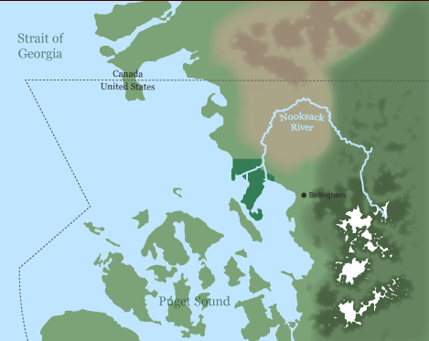
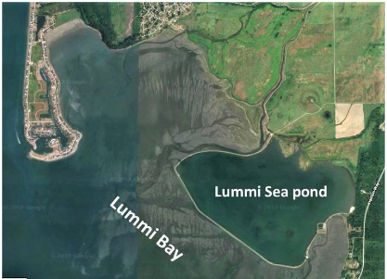
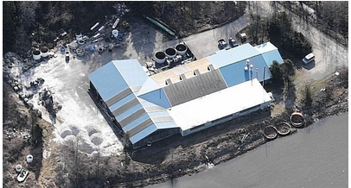
Lummi refer to themselves as the Lhaq-temish, or people of the sea
Top image: Lummi Nation, Meet the People, American Indian Museum, 2013. https://americanindian.si.edu/environment/lummi/People.cshtml
Left image: Lummi Sea Pond, Puget Sound Estuary Project, 2022. https://pugetsoundestuary.wa.gov/wp-content/uploads/2022/01/NTA2018-0884_WDFW_Initial_Factsheet.pdf
Shellfish Hatchery Building Image: Lummi Nation Natural Resources. https://www.lummi-nsn.gov/Website.php?PageID=42

Slide 3
Historical Question:
Why did Lummi Nation build an aquaculture facility in the 1970s?

Slide 4
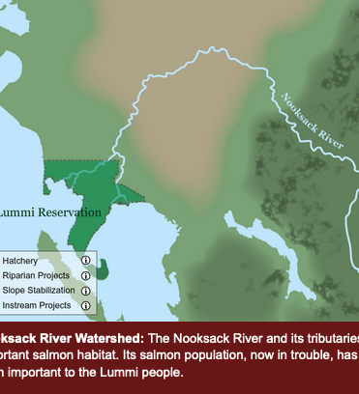
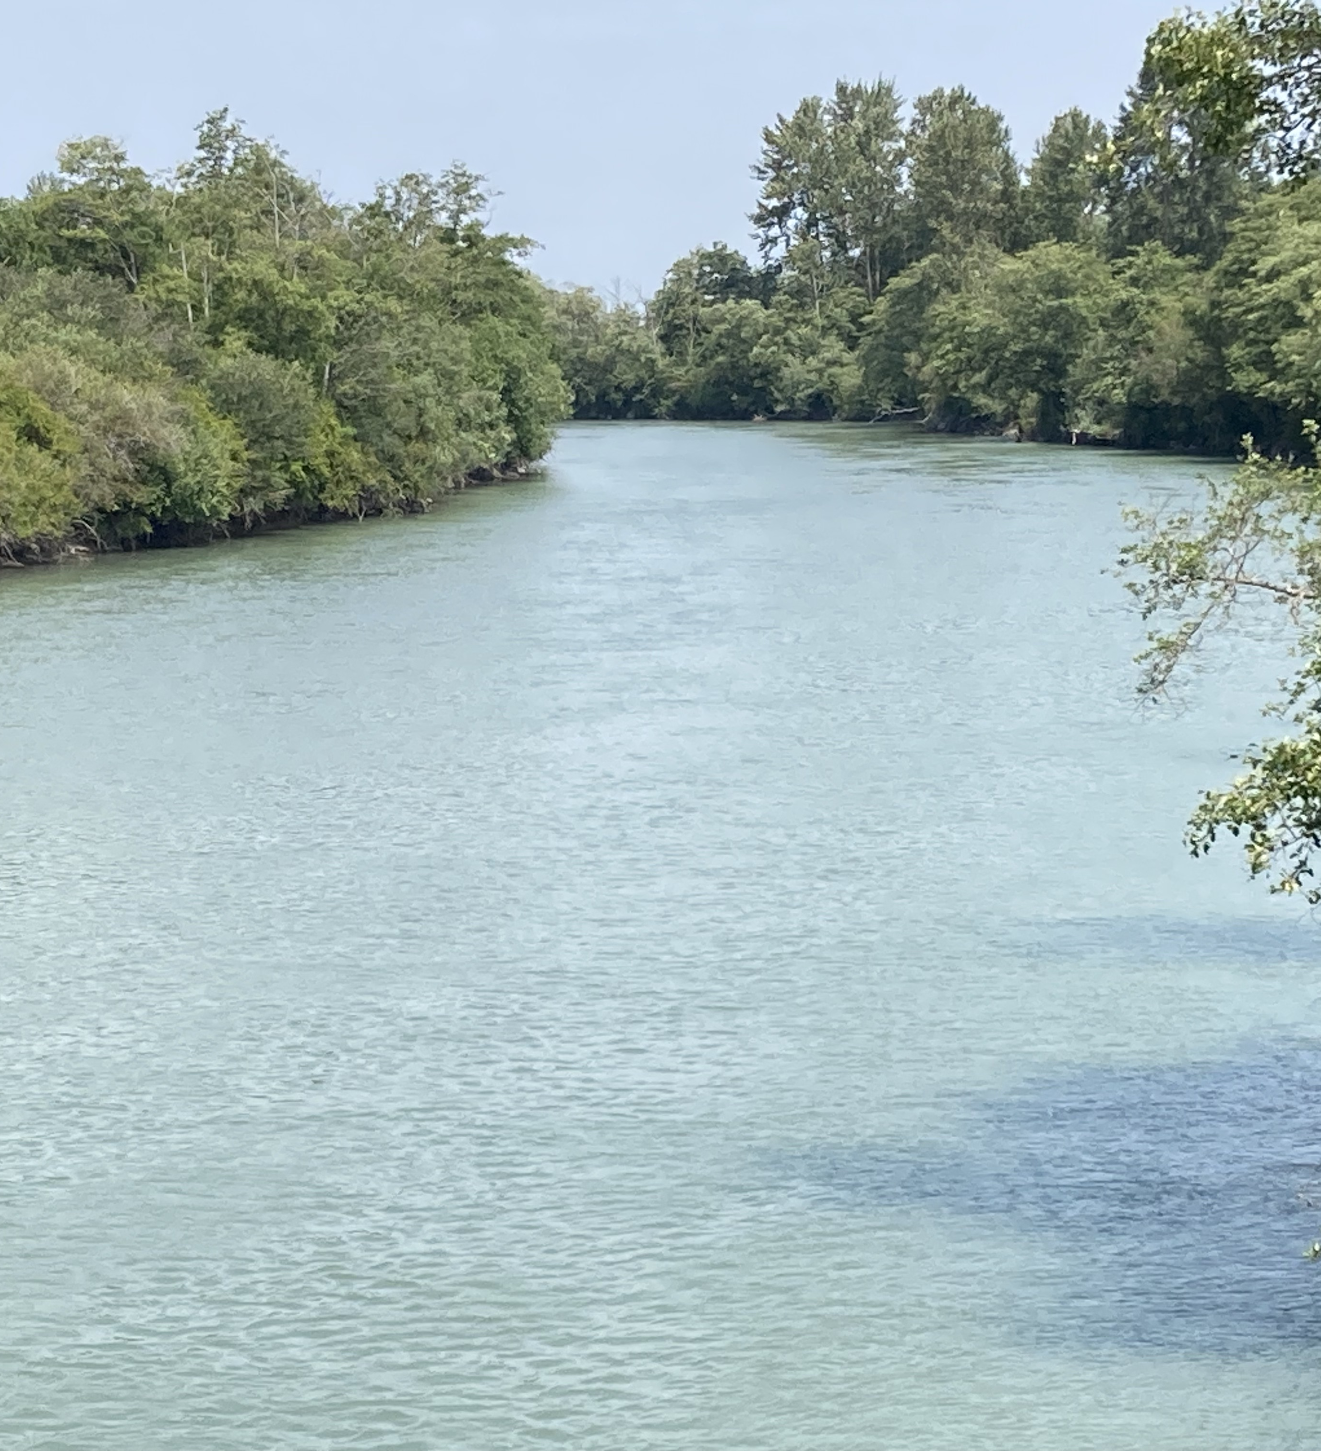
Nooksack River
Image source: Lummi Nation, Meet the People, American Indian Museum, 2013. https://americanindian.si.edu/environment/lummi/People.cshtml
Photo: Daniel Chard, July 2023

Slide 5
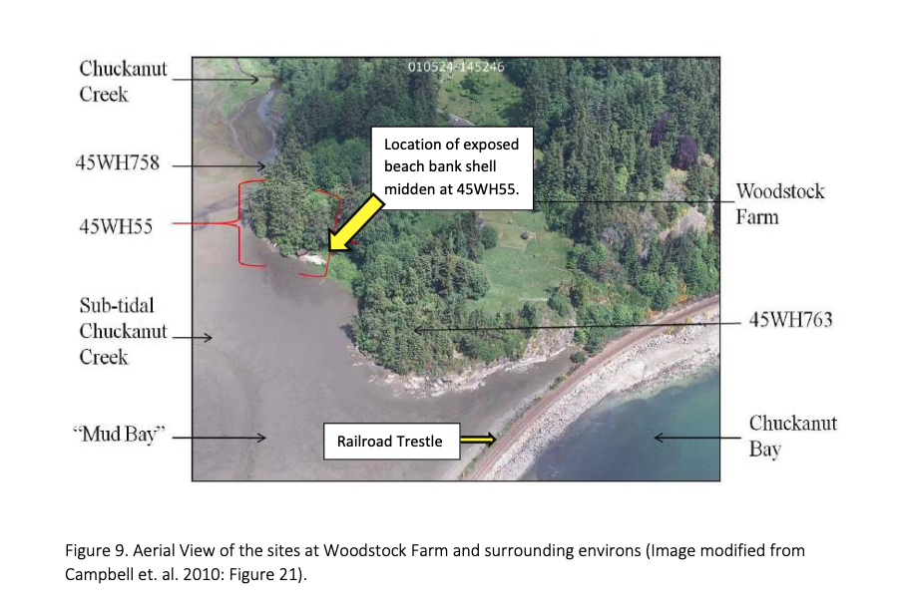
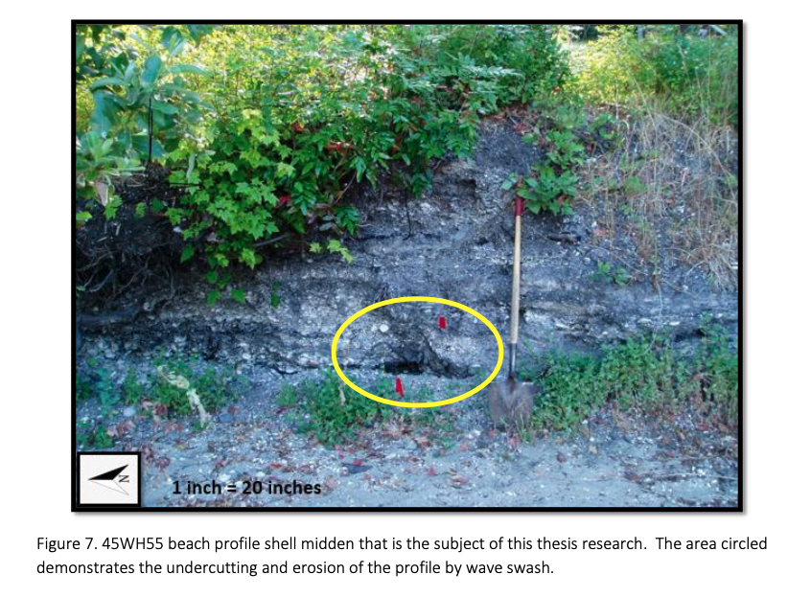
Shell Middens on the Northwest Coast: evidence of historical shellfish feasts
Woodstock Farm
Beach profile

Slide 6
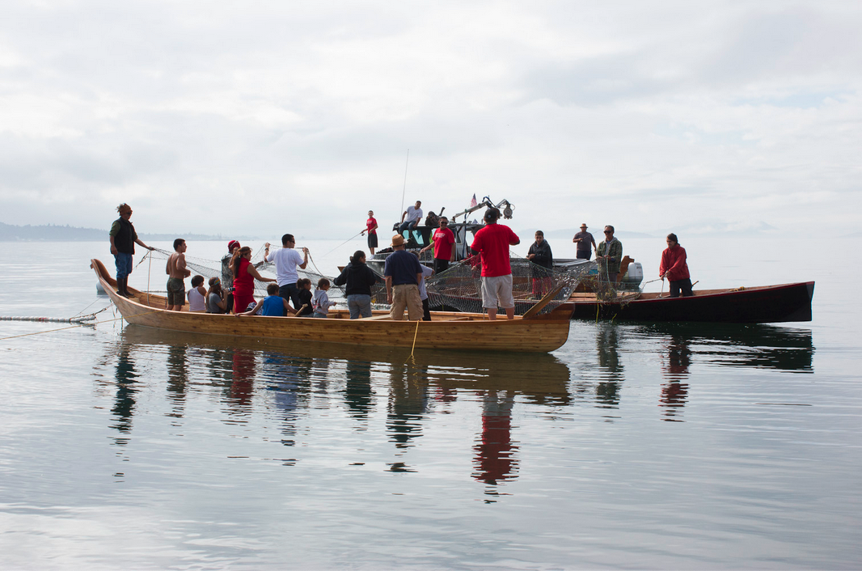
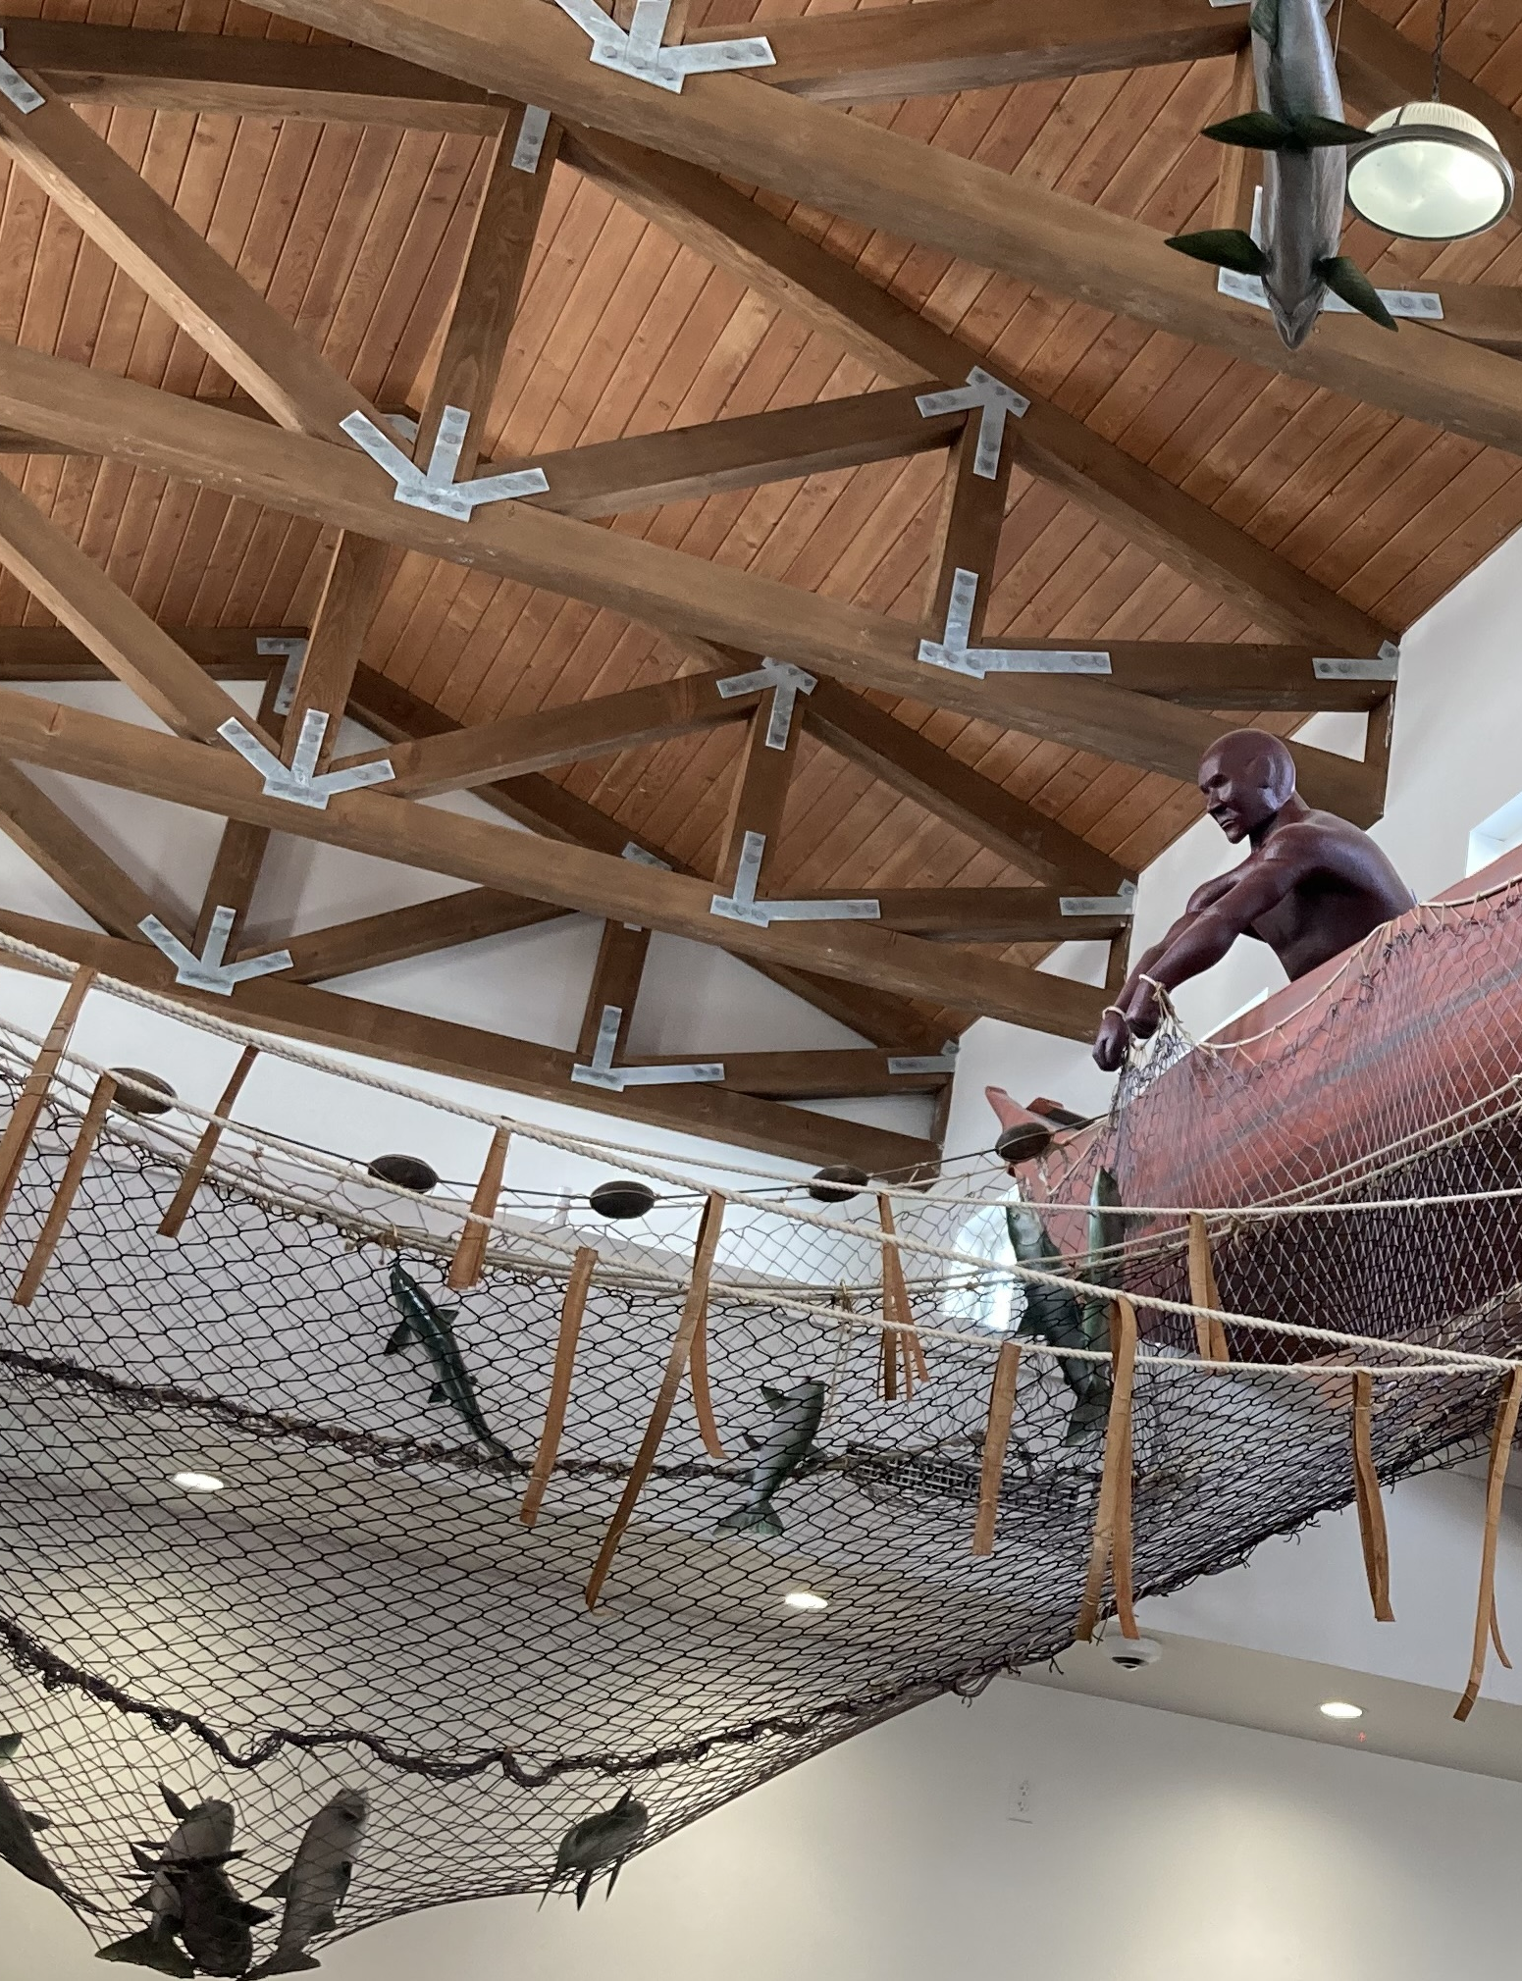
Reef Net Fishing
Above: NW Indian Fisheries Commission circa 2013
Right: Photo by Dan Chard, 2023 - Dean Washington on canoe, Rick Kinley on the net, Lummi Bay Market

Slide 7
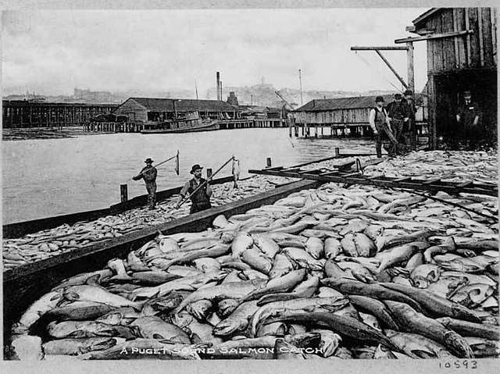
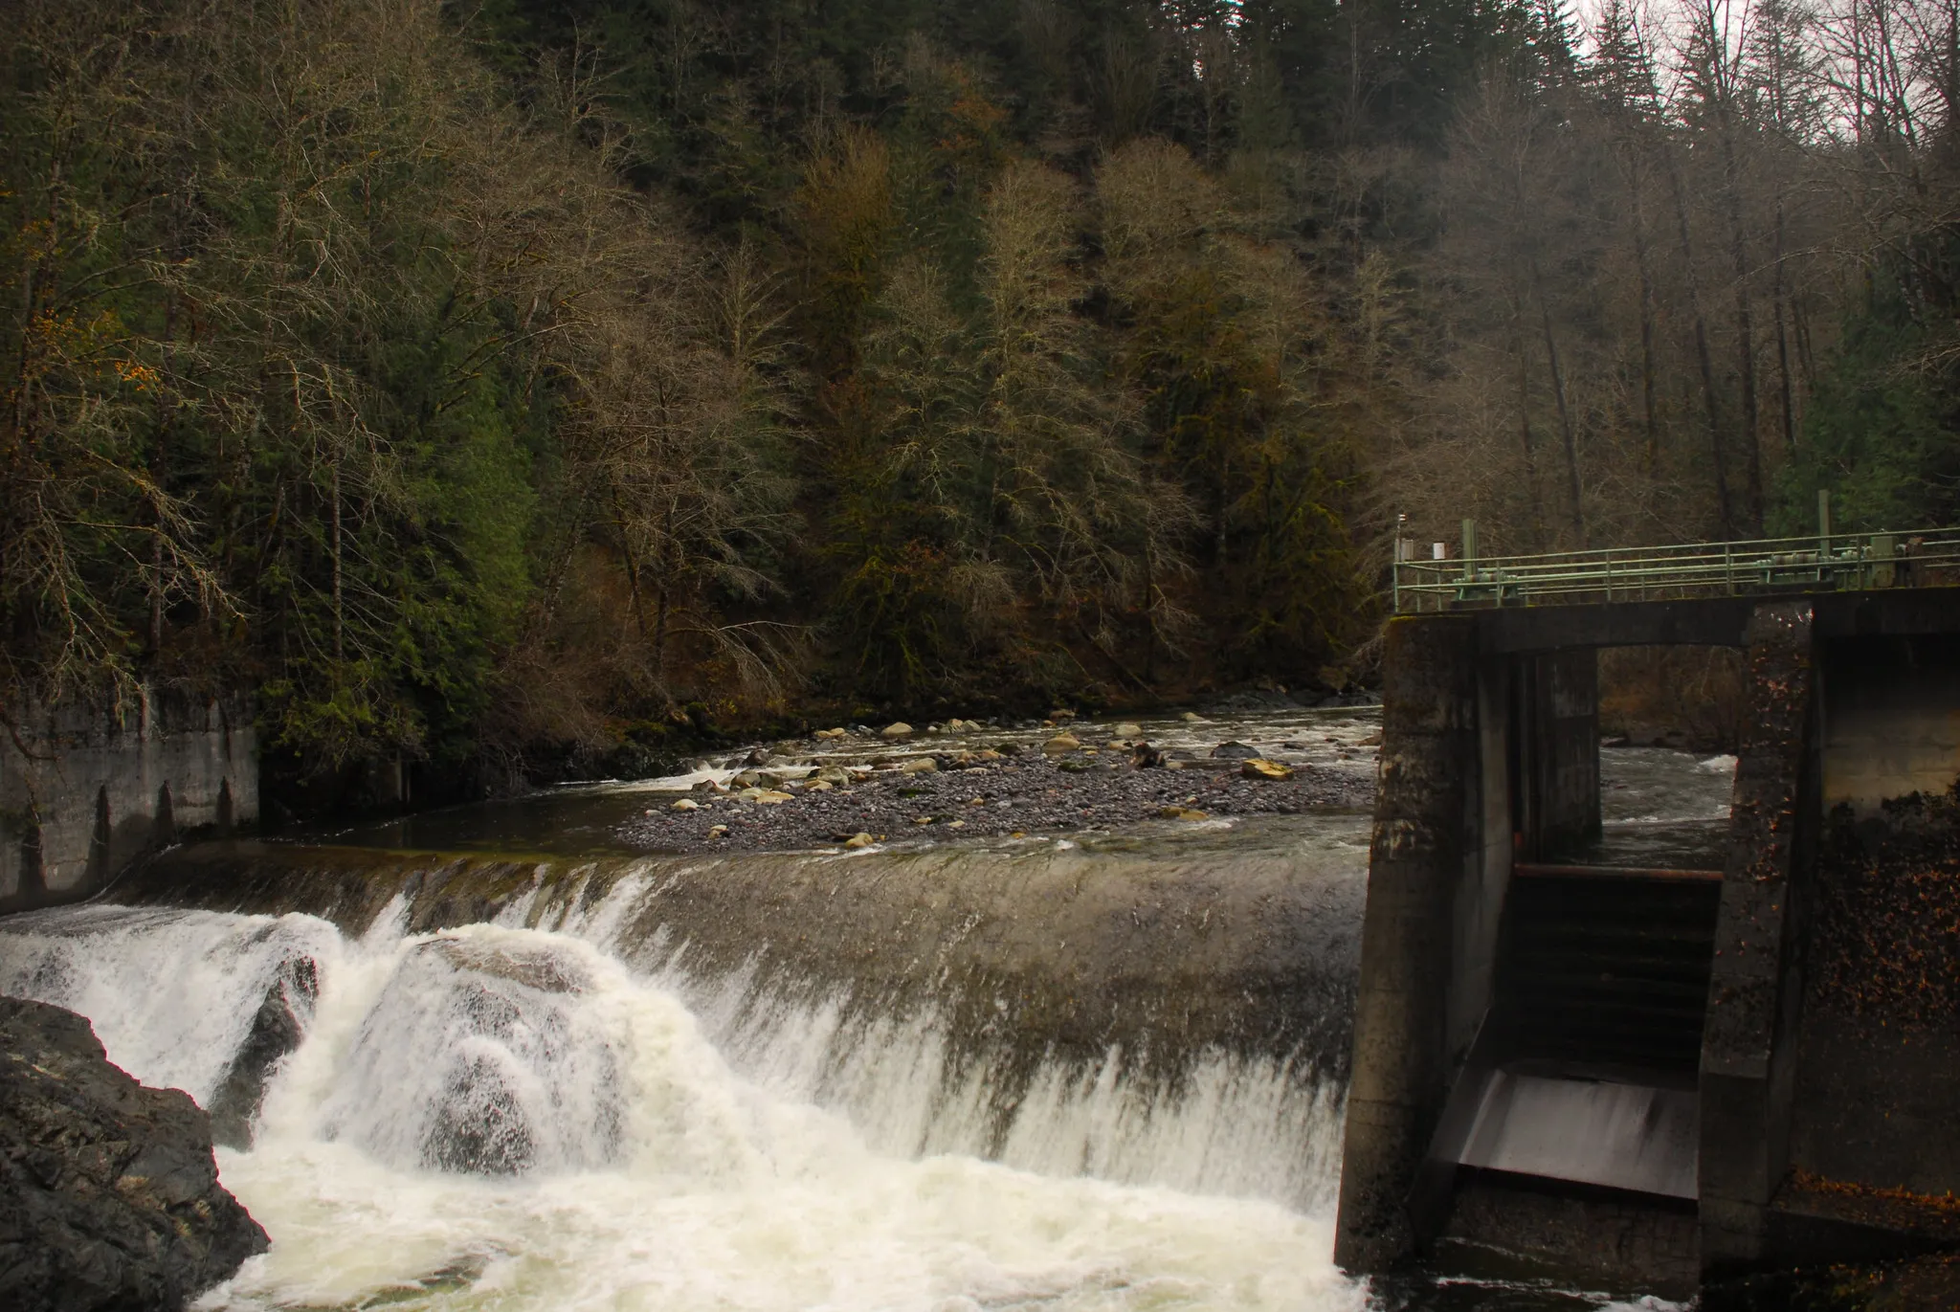
More fisherman competing for fewer and fewer fish in the Salish Sea
Puget Sound Salmon Catch (1900)
Source: Museum of History and Industry
Dam on the Nooksack River prior to removal
Source: Thomas O’Keefe for American Whitewater (2021)

Slide 8
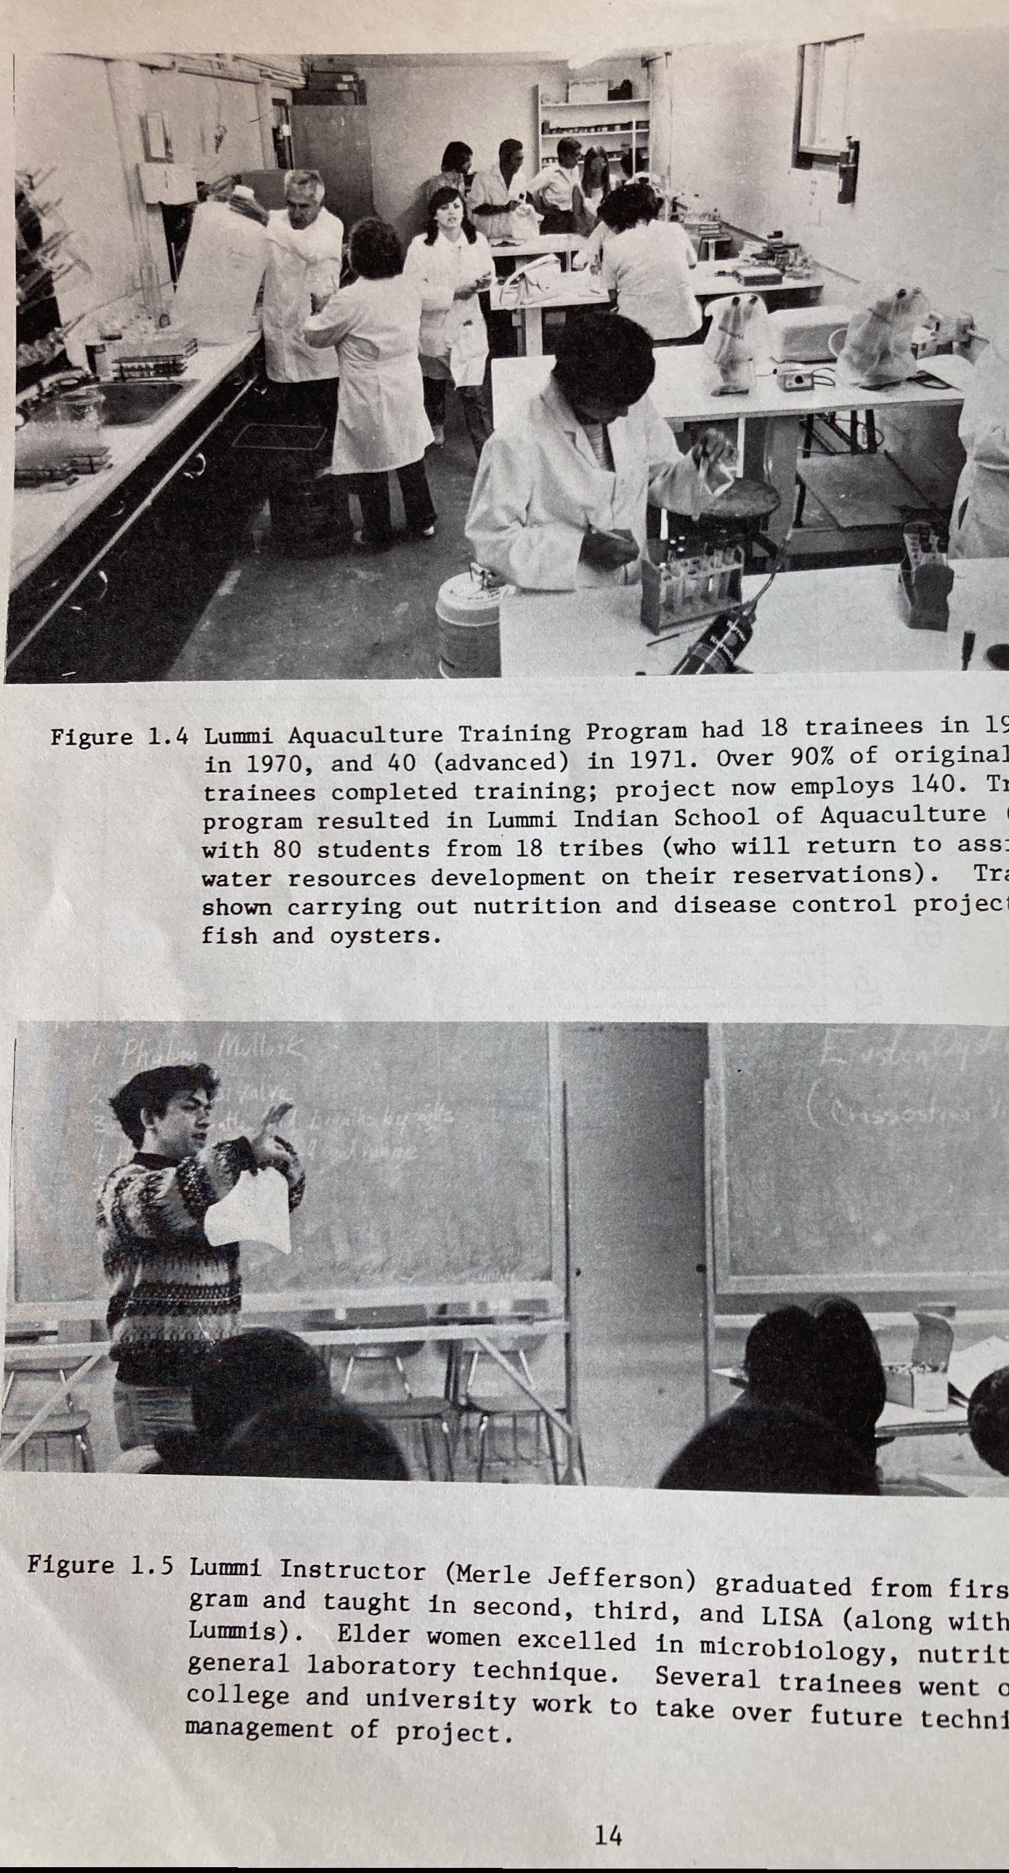
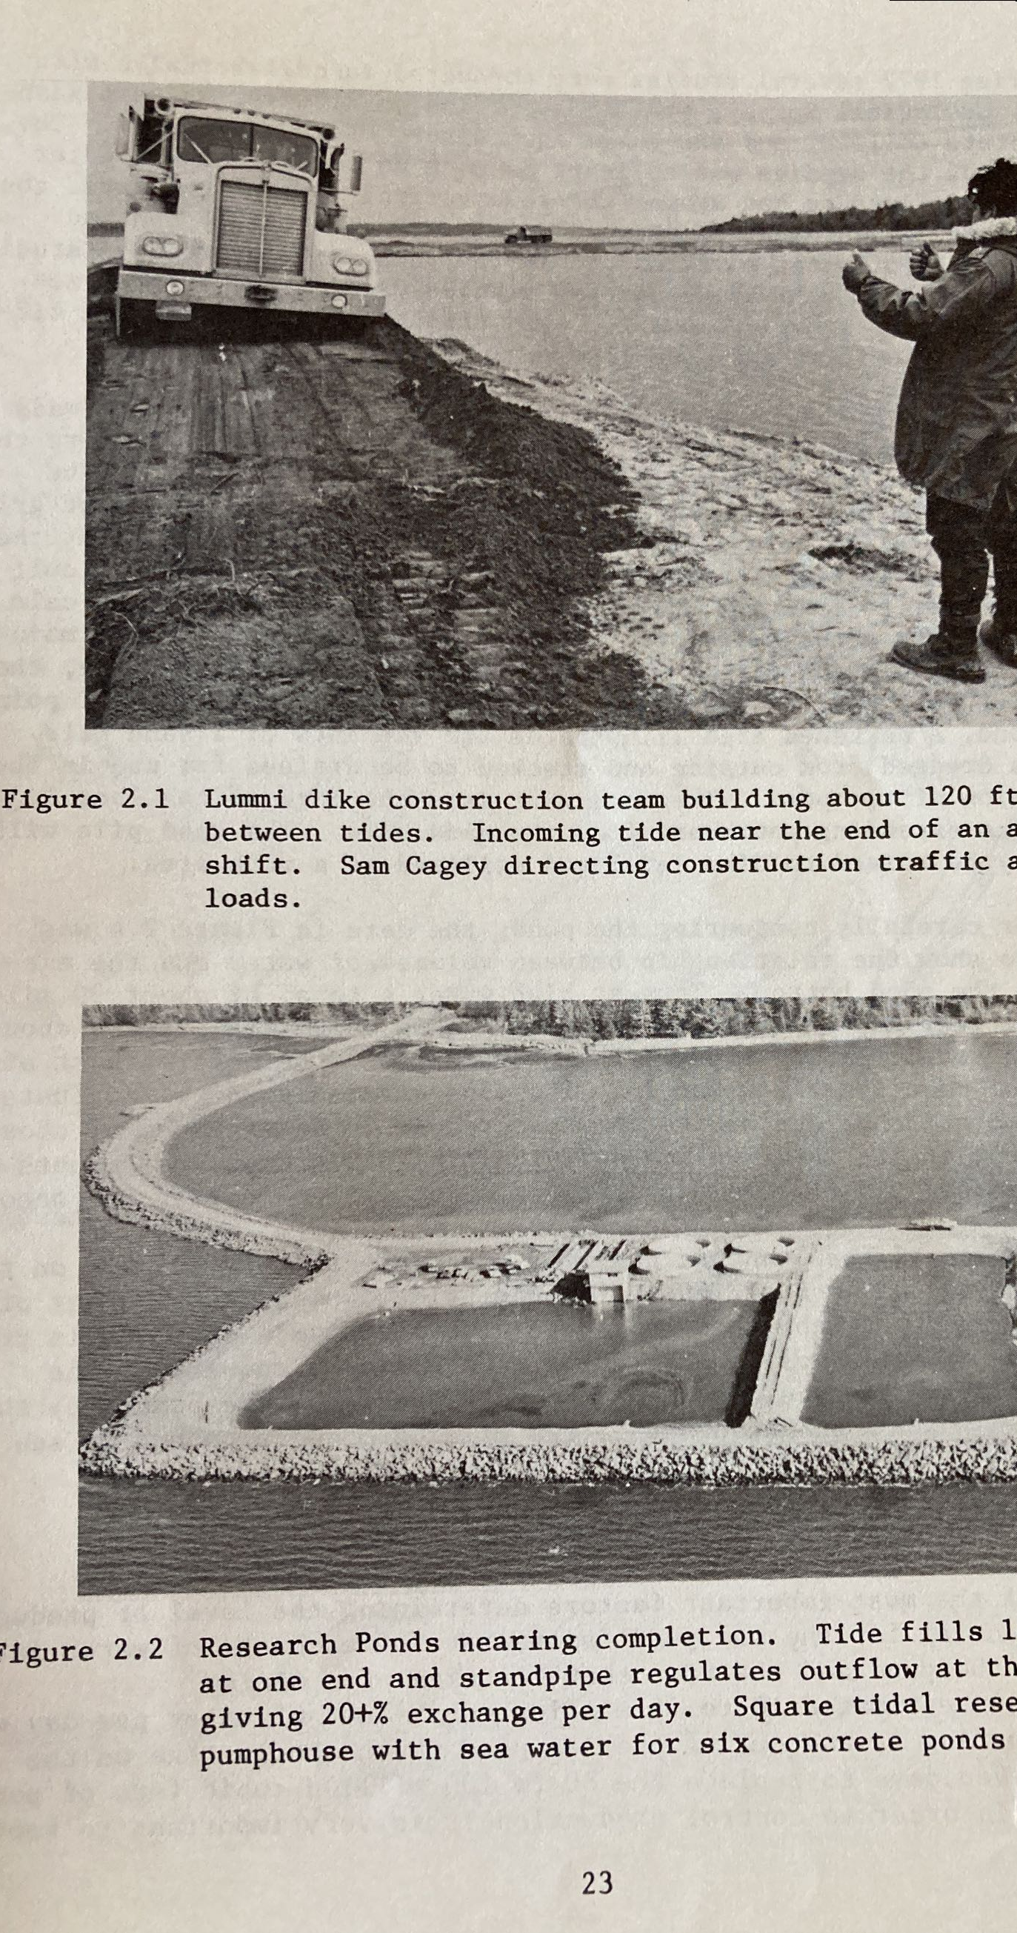
Left image: students in the Lummi Indian School of Aquaculture, ca. 1972
Right image: Sam Cagey, member of the Lummi Indian Business Council, directs a truck during the construction of the Sea Pond, circa 1970
SOURCE: Wallace Heath, et. al., Lummi Aquaculture: Final Report to the Economic Development Administration (1975)

Slide 9
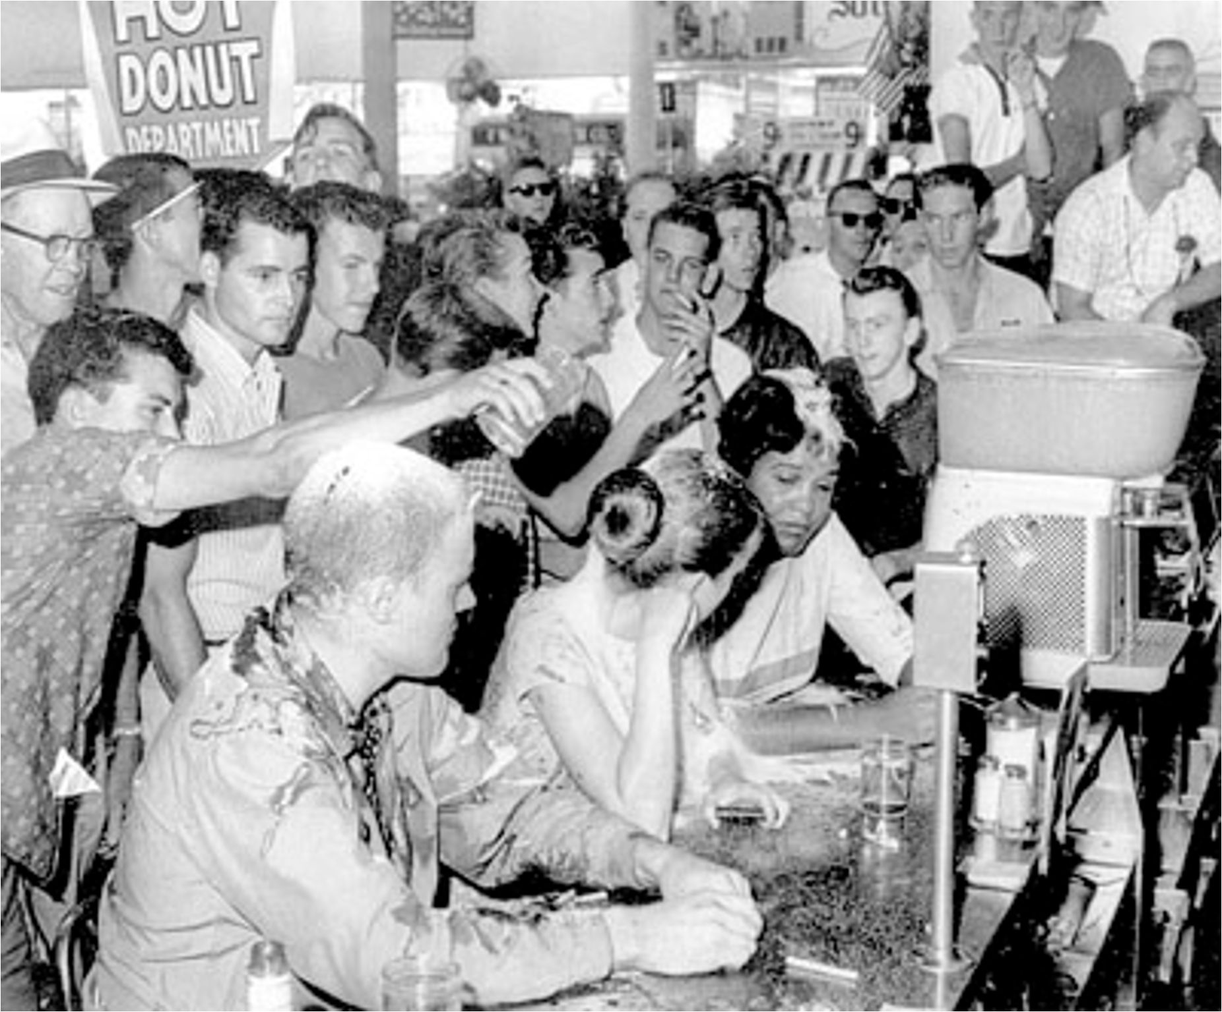
From Civil Rights to “Fish-ins”
Civil rights protesters attacked during a “sit-in” at a segregated Woolworth’s lunch counter in Jackson, Mississippi, May 28, 1963 (SOURCE: Jackson Daily News)
Actor Marlon Brando and Puyallup activist Bob Satiacum before their arrest at a “fish-in” on the Puyallup River, March 2, 1964 (SOURCE: Seattle Post-Intelligencer)

Slide 10
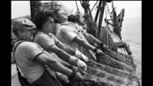
Video Slide “Lisa Cook Capstone Presentation”
Lisa Cook Capstone Presentation - Time Immemorial, NWIC Videos.

